Slide 1
Paper 1: Mechanics and Properties of Matter Module-3
Programme: | B.Sc.
Subject: | Physics
Semester: | I semester
University: | Davangere
Session: | 06

Slide 2
Rotation of a Rigid body
Session 6-Syllabus
1. Moment of inertia in solid sphere

Slide 3
Learning Objectives
After this session, students will be able to:
Understand basic properties of moment of inertia of a Spherical Shell.
Understand basic properties of moment of inertia of solid sphere.

Slide 4
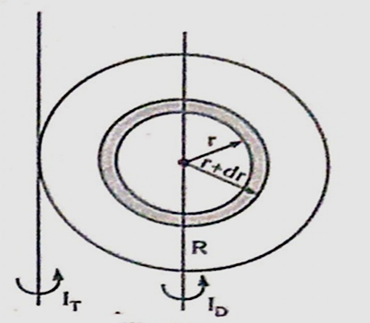
Moment of inertia of a solid sphere
Consider a solid sphere of radius R and mass M.
Imagine that this sphere consists of a large number of concentric spherical shells.
Consider one such of radii r and thickness dr.

Slide 5
The mass of the shell = area x mass per unit volume
= (4πr²dr) m
= 4πmr²dr
The moment of inertia of the shell about a diameter is,
$\frac{2}{3}$ (mass) ${\left(radius\right)}^{2}$ = $\frac{2}{3}$ x 4πmr²dr x r² = $\frac{8πm}{3}$ r⁴ dr
( The Sphere is made up of number of
such shells between 0----R )

Slide 6
The moment of inertia of the sphere about the diameter is,
I_{D} = $\int_{0}^{R}{\frac{8πm}{3} r^{4} dr}$
I_{D} = $\frac{8πm}{3}$ ${\left[\frac{r^{5}}{5}\right]}_{0}^{R}$ = $\frac{8πm}{3}$ $\frac{R^{5}}{5}$ = $\frac{2}{5}$ $\frac{4πR^{3}m}{3}$ R² = $\frac{2}{5}$ MR²
I_{D} = $\frac{2}{5}$ MR²
Where M = $\frac{4}{3}$ πR³m ---- mass of the sphere.

Slide 7

The moment of inertia of the sphere about any tangent is,
I_{T} = I_{D} + MR²
I_{T} = $\frac{2}{5}$ MR² + MR²
I_{T} = $\frac{7}{5}$ MR²

Slide 8
Work Sheet
Two mark questions:
Derive the expression for moment of inertia in solid sphere -8 Mark
Reference Books:
1. Elements of Properties of Matter – By D.S.Mathur
2. Physics for Degree Students - B.Sc First Year - By C.L.Arora , P.S. Hemne
3. College Physics-Vol-1 By N .Sundar Rajan and others

